Slide 1
SAP Presentation
Banking

Slide 2
Preparing Cheques for Payment Documents
S.NO. : 03- FI-Bank- 01
TRANSACTION CODE : FCH5
ACCESS PATH :SAP Easy Access- Accounting Financial Accounting- Banks- Environment- Check balance- Create- Manual Checks
We get “ Create Check Information” screen as under;
Required fields
Payment Document Number Enter the payment Document Number
Paying Company Code Default (Grow)
Fiscal Year Default (eg: 2001)
House bank To be entered (eg: Cbi)
Account ID To enter the A/c Number maintained in the bank
Check Number next free number of the cheque to be entered
Incorporating the above we get the “ Create Check Information” screen as under

Slide 3
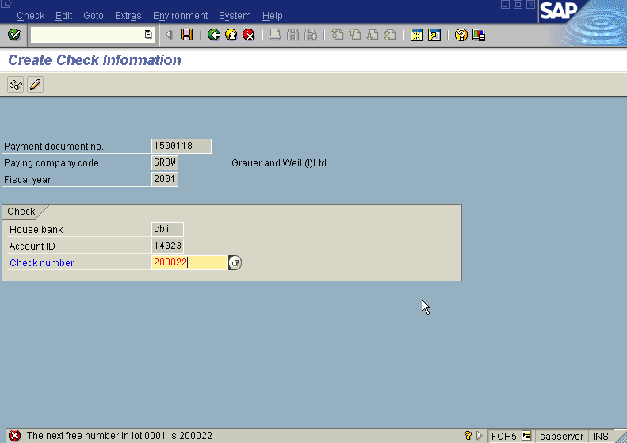
Press Enter icon
The system displays “ Create Check Information” screen as under

Slide 4
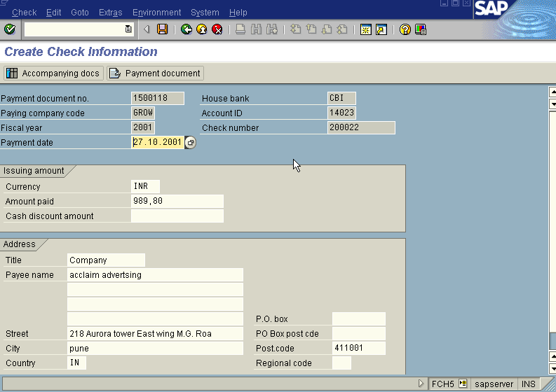
Verify all the details viz; amount, payee, etc. And make necessary changes
if required before saving the document.
Press save icon
We get the following message as under
End of the process.

Slide 5
Cheque Printing
S.NO. : 03- FI-Bank- 06
TRANSACTION CODE : ZCPR
We get “ Check Printing” screen
Required fields
Document Number : The saved Outgoing Payment document
number to be entered
Document date : Optional
Check Number : Optional
Press Execute Button/F8
The system displays a Payment advice note and cheque for outgoing payment
wherein we can insert the Payment advice note on the printer and take the print out.
For Incoming Payment
Enter the incoming payment document number from the same transaction code ZCPR
You can print only payment advice for incoming payments as no check printing is
required.

Slide 6
Display Cheque Register for Payment Documents
S.NO. : 03- FI-Bank- 03
TRANSACTION CODE : FCHN
ACCESS PATH :SAP Easy Access- Accounting - Financial Accounting - Banks – Environment - Check balance - Display - For Check Register
We get “Check Register” screen
Required fields
Paying Company Code : To be entered (Grow)
House bank : To be entered (eg: CBI)
Account ID : To be entered (eg: 14023)
Press Execute Button / F8
The system gives output of the Check Register giving details of cheque nos., payment document nos., cheques voided details, payment date, party to whom the cheque is paid etc.
End of the Process.

Slide 7
Display Cheques for Payment Documents
S.NO. : 03- FI-Bank- 02
TRANSACTION CODE : FCH1
ACCESS PATH :SAP Easy Access- Accounting- Financial Accounting- Banks- Environment- Check balance- Display For Checks
We get “ Display Check Information” screen
Required fields
Paying Company Code : To be entered (Grow)
Check Details Viz, House bank, and Account ID fields to be entered
Then go to top of the screen
Press Check → List
We get “ Check Information- List ” screen
Required fields
Paying Company Code : To be entered (Grow)
Check Details Viz, House bank, and Account ID fields to be entered
Press execute Button/F8
We get “ Check Information- List ” screen as under

Slide 8
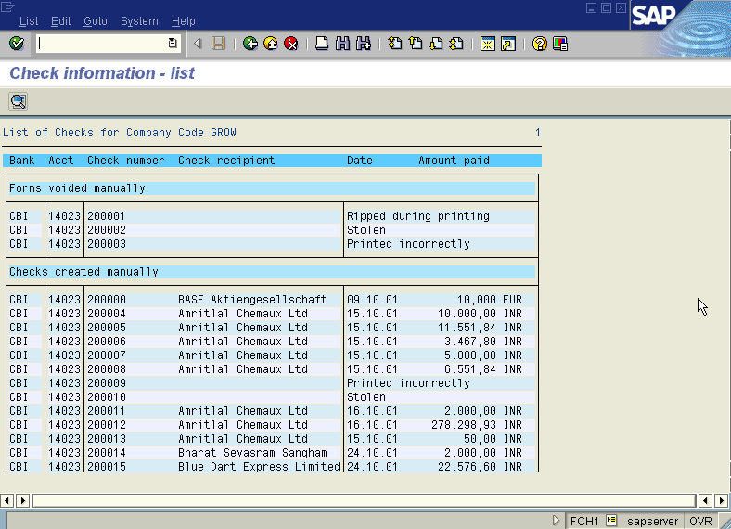

Slide 9
Voiding of Cheques
S.NO. : 03- FI-Bank- 04
A) Unused checks : These checks are voided only if they get damaged before issuing.
TRANSACTION CODE : FCH3
ACCESS PATH :SAP Easy Access- Accounting- Financial Accounting- Banks- Environment- Check balance - Void -Unused cheque
We get “ Void Checks Not used” screen
Required fields
Paying Company Code : To be entered (Grow)
House bank : To be entered (eg: CBI)
Account ID : To be entered (eg: 14023)

Slide 10
Cheque Number : To be entered ( no. of the cheque to be voided)
Void reason Code : Reason for voiding the check has to be selected from the drop down menu
Press Enter/ Void Button
The system displays the message the check has been voided.
End of the Process.
B) Issued checks : These checks are voided only if they get damaged after issuing.
TRANSACTION CODE : FCH9
ACCESS PATH :SAP Easy Access- Accounting - Financial Accounting- Banks- Environment- Check balance- Void -Issued cheque
We get “ Void Issued Checks ” screen
Required fields

Slide 11
Paying Company Code : To be entered (Grow)
House bank : To be entered (eg: CBI)
Account ID : To be entered (eg: 14023)
Cheque Number : To be entered ( no. of the cheque to be voided)
Void reason Code : Reason for voiding the check has to be selected from the drop down menu
Press Void Button
The system displays the message the check has been voided and Payment document not reversed.
End of the Process.

Slide 12
C) Cancel Payments : These checks are voided only if they get damaged after issuing.
TRANSACTION CODE : FCH8
ACCESS PATH :SAP Easy Access- Accounting- Financial Accounting- Banks - Environment
- Check balance- Void- Cancel Payment
We get “ Cancel Check Payment ” screen
Required fields
Paying Company Code : To be entered (Grow)
House bank : To be entered (eg: CBI)
Account ID : To be entered (eg: 14023)
Cheque Number : To be entered ( no. of the cheque to be voided)
Void reason Code : Reason for voiding the check has to be selected from the drop down menu
Reversal reason : Reason as to why the payment has to be cancelled
Press Cancel Payment Button
The system displays the message “payment for check cancelled and generates a new reversal document.
End of the Process.

Slide 13
Bank Master Preparation
Creation of Bank Master
S.NO. : 03- FI-Bank- 07
TRANSACTION CODE : FI01
ACCESS PATH : SAP Standard Menu →Accounting → Financial Accounting → Banks → Master Data → Bank Master Record → Create
We get “Create Bank – Initial Screen”
Enter the relevant fields
Bank Country : IN
Bank Key: BNP
Press Enter
The System displays “Create Bank – Detail Screen”
Fill the mandatory fields marked as Question Mark
And press icon Address appearing on the left side corner of the screen or press F7
The System displays a pop up screen with Heading Bank in (with the Bank Key defined as extension).

Slide 14
Fill the following fields; Name, Search term, Street Address, PO Box Address and Communication details.
Press icon Copy
The system copies everything written on the main Screen
Finally Press Save
Change of Bank Master
TRANSACTION CODE : FI02
ACCESS PATH : SAP Standard Menu →Accounting → Financial Accounting → Banks → Master Data → Bank Master Record → Change
We get “Change Bank – Initial Screen”
Enter the relevant fields
Bank Country : IN
Bank Key: BNP
Press Enter

Slide 15
The System displays “Change Bank – Detail Screen” with the bank name and other relevant details. Make the necessary changes at these place or click F7 or the Address icon and make the correction in the pop up screen displayed by the system.
Finally press Save.
Display of Bank Master
TRANSACTION CODE : FI03
ACCESS PATH : SAP Standard Menu →Accounting → Financial Accounting → Banks → Master Data → Bank Master Record → Display
We get “Display Bank – Initial Screen”
Enter the relevant fields
Bank Country : IN
Bank Key: BNP
Press Enter
The System displays “Display Bank – Detail Screen” with the bank name and other relevant details.
Finally press Save.

